Slide 1
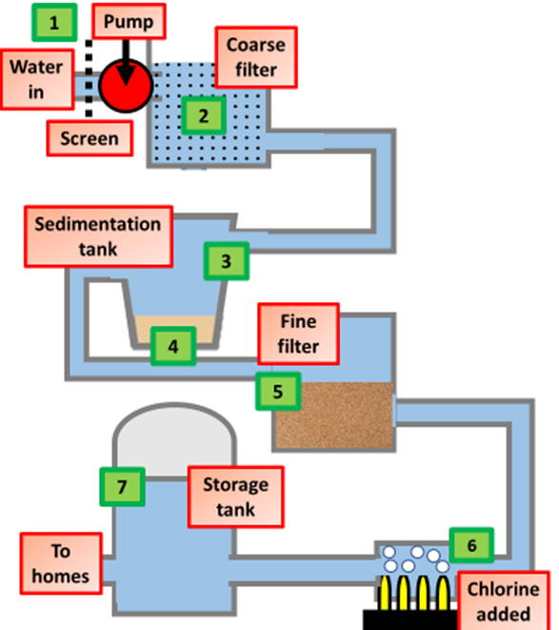
Water Treatment Question
Specification Link:
Using Resources: 4.10.1.2
Highlight key words in the information below:
Raw water may contain dissolved salts and minerals, microbes, pollutants and insoluble materials like sand and stones. Water is treated to remove any harmful components before being fed into the public supply. This is done in several ways:
Filtration - the water is sprayed onto specially-prepared layers of sand and gravel. As it trickles through, different-sized insoluble solids are removed. The filter beds are cleaned periodically by pumping clean water backwards through the filter.
Sedimentation - a chemical is added which causes tiny solid particles (which would pass through a filter) to clump together into larger particles. These can then be allowed to settle out or may be filtered.
Chlorination - chlorine gas is injected into the water to sterilise it. The chlorine kills microbes.
The diagram shows how water is treated. Summarise this process:
__________________________________________________________________________________________________________________________________________________________________________________________________________________________________________________________________________________________________________________________________________________________________________________________________________________________
What is the purpose of running water through a screen?
____________________________________________________________________________
What is the purpose of the sedimentation tank and what is added to the water?
____________________________________________________________________________
What is the purpose of running water through a fine filter?
____________________________________________________________________________
Chlorine is used to make bleaches, plastics and medicines. Swimming pool water is often treated with chlorine.
Chlorine is used to make water safe to drink. It is relatively cheap and easy to use. People who drink untreated water risk dying from typhoid and cholera.
However, chlorine is a poisonous chemical. It causes breathing difficulties and can kill people. Some people are also allergic to chlorine.
What is the purpose of adding chlorine to the water?
____________________________________________________________________________
Highlight key words or phrases
Developing countries are likely to choose chlorination as their method of making water safe to drink. Suggest why.
____________________________________________________________________________________________________________________________________________________________________________________________________________________________________________________________
Describe how the equipment to the left could be used to measure the rate of photosynthesis:
_______________________________________________________________________________________________________________________________________________________________________________________________________________________________________________________________

