Slide 1
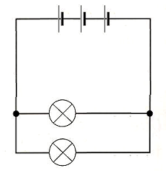
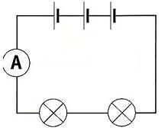
Some students set up a circuit and decided to measure the current at different points around the circuit.
A diagram of their circuit is shown below.
Ammeter 1 measured a current of 6 amps
What was the current reading shown on:
Ammeter 2__________
Ammeter 3_________
The students set up another circuit and decided to measure the current at different points around the circuit. A diagram of their circuit is shown below.
Ammeter 1 measured a current of 12 amps
What was the current reading shown on:
4) Ammeter 2__________
5) Ammeter 3_________
6) Ammeter 4 _________
4
1
2
3
1
3
The students set up another circuit and decided to measure the voltage at different points around the circuit. A diagram of their circuit is shown below.
What was the voltage reading shown on:
7) Voltmeter 1__________
8) Voltmeter 2 _________
9) Voltmeter 3 _________
2
3) Use the words below to complete the paragraph
Series : Parallel : Different : The same
Their results showed that in a _____________circuit The current is ___________at each point in the circuit
6V
V₁
V₂
V₃

