Slide 1
Uses of Electromagnets

Slide 2
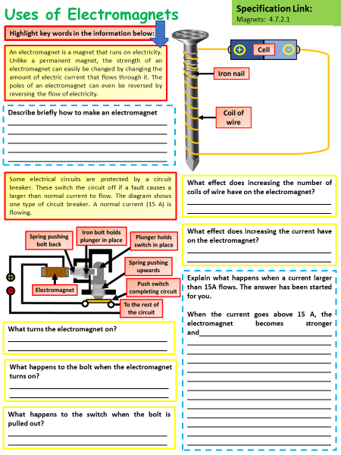
Uses of Electromagnets
Question Activity
How to use this activity
Download the worksheet from the link in the description
Watch the video pausing it if needed to note down key points
Fill out the short answer questions
Use your answers to construct a long answer question on the uses of electromagnets

Slide 3
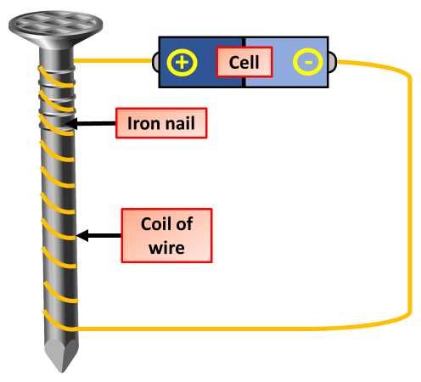
Uses of Electromagnets
Introduction
When an electric current flows in a wire it creates a magnetic field around the wire. By winding the wire into a coil we can strengthen the magnetic field. Electromagnets are made from coils like this.
We can make an electromagnet stronger by:
wrapping the coil around an iron core
adding more turns to the coil
increasing the current flowing through the coil

Slide 4
Uses of Electromagnets
Circuit Breaker
A spring-loaded push switch is held in the closed position by a spring-loaded soft iron bolt.
An electromagnet is arranged so that it can pull the bolt away from the switch.
When the live wire carries the usual operating current, the electromagnet is not strong enough to separate the contacts.
If something goes wrong with the appliance and a large current flows
The electromagnet will pull hard enough to separate the contacts and break the circuit.

Slide 5
Uses of Electromagnets
What turns the electromagnet on?
What happens to the bolt when the electromagnet turns on?
What happens to the switch when the bolt is pulled out?
Explain what happens when a current larger than 15A flows. The answer has been started for you.

