Slide 1
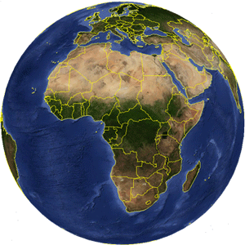
Harnessing Energy from Our Planet
How do we obtain and use energy from the planet?
Notes:
http://inspirationgreen.com/toxic-beauty.html

Slide 2
The spheres of our planet:
The hydrosphere | The Earth’s water
The Lithosphere | The Earth’s land
The atmosphere | The layer of gas (air) that surrounds the planet
The biosphere | All living beings on the planet

Slide 3
Renewable vs. Non-Renewable Sources of Energy
Renewable Energy | Energy from a source that is not depleted when used (does not get used up).
Non-Renewable Energy | Energy from a source that is not easily replaced in nature. Once the source gets used up, you will need to generate more in order to obtain energy from this source. It may take thousands of years for these sources to replenish themselves.

Slide 4
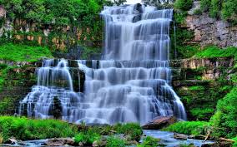
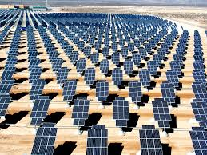
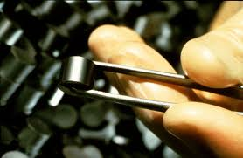
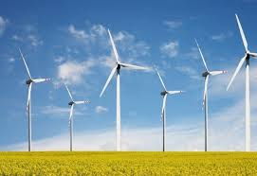
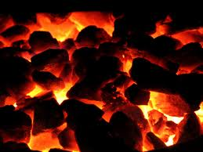
What do you think? Renewable or not?

Slide 5
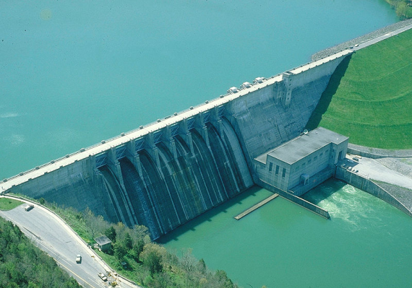
Energy and the Hydrosphere
Hydraulic energy: energy from moving water.

Slide 6
How do we obtain hydraulic energy?
Hydroelectric power plants use the movement of falling water to spin turbines which are located inside dams built across a river.
Water falling through a dam spins a turbine that converts mechanical energy into electrical energy.
Hydroelectricity is the main source of energy in Quebec.

Slide 7
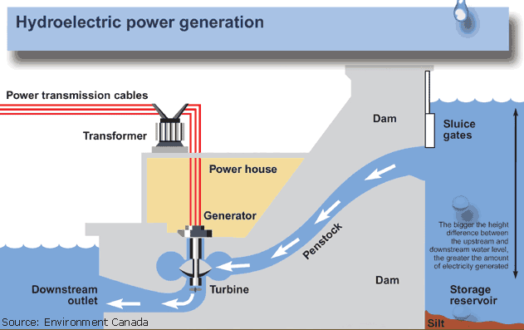

Slide 8
Wave Energy
Wave Energy: energy from the movements of currents.
How to obtain it?
Wave energy is produced when the energy contained in the movement of water is harnessed using buoys, which rise and fall with the waves.
Ocean currents are able to spin underwater turbines, which are similar to wind turbines.
The mechanical energy produced by the movement of the buoys and blades can be converted into electrical energy.

Slide 9
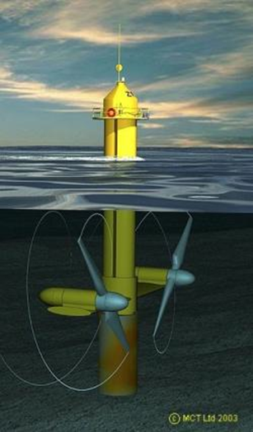

Slide 10
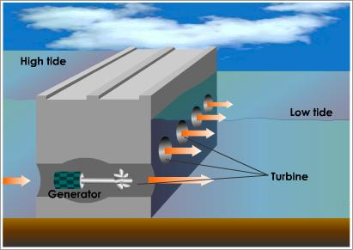
Tidal Energy
Electricity can be generated from tides when water from a high tide is collected (sometimes using a dam) and then falls through turbines converting mechanical energy into electrical energy are used.

Slide 11
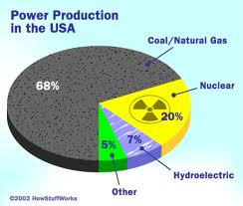
Energy From the Lithosphere

Slide 12
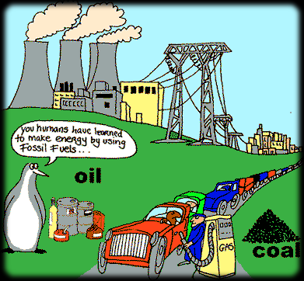
Fossil Fuels
Fuels resulting from the transformation of organic residue.
These energy sources consist of oil, natural gas and coal.
They form from the pressure of several layers of sediment over decaying organic matter.
This process takes millions of years.

Slide 13
How do we obtain it?
The burning of fossil fuels releases a lot of thermal energy (heat).
This thermal energy is used to create steam by boiling water.
The steam creates a force which can turn a turbine connected to a generator.

Slide 14
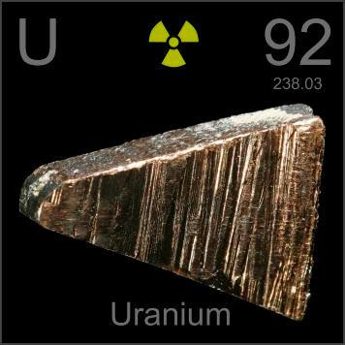
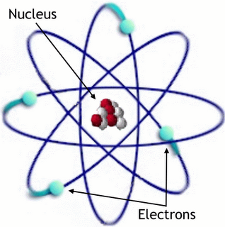
Uranium
It is a radioactive element that occurs naturally in the Earth’s crust.
Splitting the nucleus of these atoms produces a lot of nuclear energy
What is nuclear energy?
The energy contained in the nucleus of an atom.

Slide 15
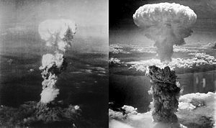
The atomic bomb
Released over Hiroshima and Nagasaki
The bombs were dropped in 1945, however the effects from these bombs have lasted even until today.

Slide 16
Problems Associated with Nuclear Energy
While nuclear energy does not release greenhouse gases such as in the burning of fossil fuels it has other consequences.
What are the 2 main concerns surrounding the use of nuclear energy?
The Disposal of waste products
Nuclear Accidents
https://www.youtube.com/watch?v=ibx0eluSiPk

Slide 17
Radioactivity
A natural process
An unstable atom transforms into one or more stable atoms
Energy is released during this process = radiation

Slide 18
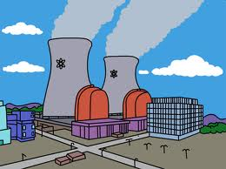
Creating Nuclear Power
By bombarding nuclei with particles or other nuclei moving at high speeds you can cause the decay/transformation of radioactive nuclei. (break them down)
This creates a large amount of thermal energy (heat), which is used to create steam by boiling water.
The steam turns a turbine which allows a generator to create electricity.

Slide 19
Advantages and disadvantages of fossil fuels
Advantages | Disadvantages

Slide 20
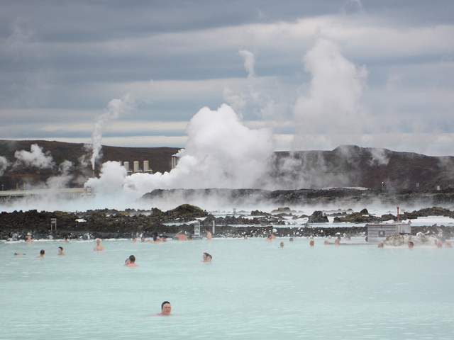
Geothermics
Geothermal energy is the energy that comes from the internal heat of the Earth.
Found mostly where hot rock is located near the Earth’s surface (near volcanoes for ex.)
This is a renewable source of energy that can be used for heating houses.

Slide 21
Energy for Tomorrow
Fossil Fuels are in danger of running out.
Nuclear Power raises concerns among the population.
Geothermal energy is very expensive.
We are trying to discover new, clean sources of energy.
Hydrogen is the most abundant element on Earth and so many efforts are directed at using hydrogen for electricity.

Slide 22
The Atmosphere

Slide 23
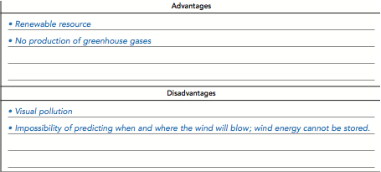
Wind Energy
The Energy that can be drawn from the wind.
How do we obtain it?

Slide 24
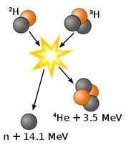
Solar Energy
Solar energy is the energy that comes from the Sun in the form of radiation through the atmosphere.
Composition: 75% hydrogen and 25% helium

Slide 25
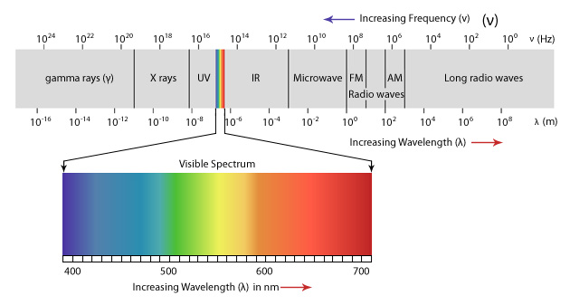
Types of Rays that make their Way to the Earth’s Surface

Slide 26
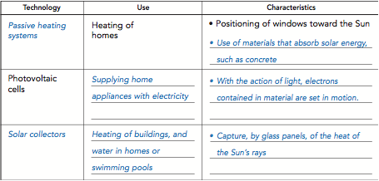
Solar Energy

Slide 27
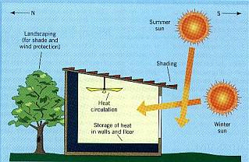
Passive Heating Systems

Slide 28
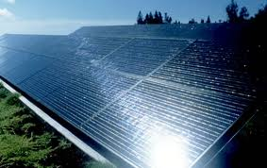
Photovoltaic Cells

Slide 29
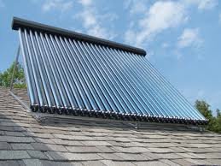
Solar Collectors

Slide 30
Advantages and Disadvantages

Slide 31
So which is which?
Renewable | Non-Renewable
Nuclear
Wind
Hydraulic, tidal, wave
Geothermal
Fossil Fuels (coal, oil, natural gas)
Solar

