Slide 1
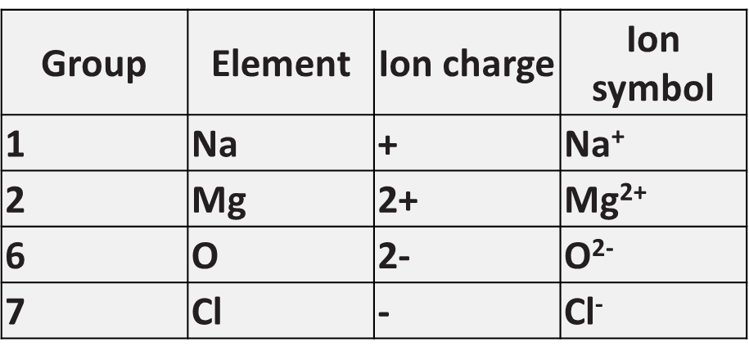
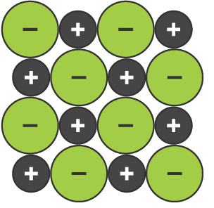
Ionic Bonding
Specification Link:
Bonding
Highlight key words in the information below:
Ionic bonding is the complete transfer of valence electron(s) between atoms. It is a type of chemical bond that generates two oppositely charged ions. In ionic bonds, the metal loses electrons to become a positively charged cation, whereas the nonmetal accepts those electrons to become a negatively charged anion.
Describe how an ionic bond forms
__________________________________________________________________________________________________________________________________________________________________________________________________________________________________________________________________________________________
Describe the formation of magnesium chloride in terms of numbers of atoms and charge
____________________________________________________________________________________________________________________________________________________________________________________________________________
Some ionic compounds have different numbers of cations and anions. ... Most of the elements that make ionic compounds form an ion that has a characteristic charge. For example, sodium makes ionic compounds in which the sodium ion always has a 1+ charge.
An ionic compound is a giant structure of ions. The ions have a regular, repeating arrangement called an ionic lattice. The lattice is formed because the ions attract each other and form a regular pattern with oppositely charged ions next to each other..
Describe the properties of a giant ionic compound
____________________________________________________________________________________________________________________________________________________________________________________________________________________________________
Magnesium chloride contains magnesium ions (Mg2+) and chloride ions (Cl⁻).
Describe, in terms of electrons, what happens when a magnesium atom reacts with chlorine atoms to produce magnesium chloride.
______________________________________________________________________________________________________________________________________________________________________________________________________________________________________________________________________________________________________________________________________________________________________________________________________________________________________________________________________________________________________________________________

