Slide 1
Ecotoxicology
The study of the ecological consequences of polluting the environment with various substances and radiation, released by human activity.

Slide 2
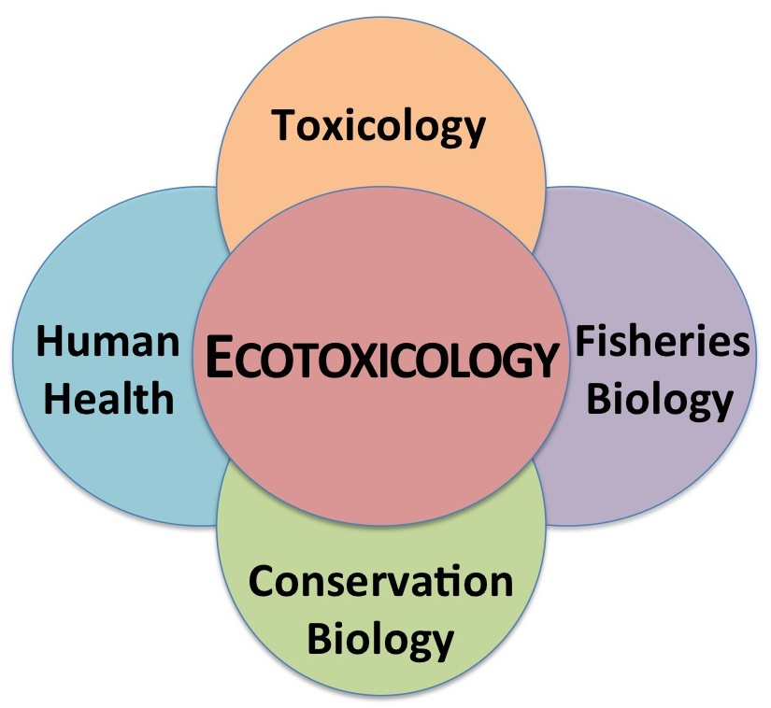

Slide 3
Human Activities
Human activities affect ecosystems by:
1) polluting them with substances that do not occur there naturally
or
2) by significantly increasing concentrations of substances already present.

Slide 4
Contaminant
any substance or radiation that is discharged into the environment and is likely to cause harm to one or more ecosystems.
“an agent that causes changes in the physical, chemical or biological properties of an environment or an organism”
4 main classes of contaminants:
Inorganic
Organic
Microbial
Radioactive

Slide 5
Class of Contaminant | Examples
Inorganic | Lead _______ Arsenic Mercury ________ Nitrogen Oxides _________ Phosphorus _________
Organic | Insecticides Pesticides Polychlorinated biphenyls ______ Benzene
Microbial | Viruses and harmful bacteria
Radioactive | Uranium _________ Plutonium _________ Radon _________

Slide 6
Toxicity
When a contaminant effectively harms an organism it is toxic!!!
Concentration
Type of organism it comes in contact with
Length of exposure

Slide 7
Concentration
The higher the concentration the greater the risk.
e.g. ≥ 0.01 ppm or 0.01 mg/L lead in water

Slide 8
Type of Organism
Certain contaminants are toxic to some organisms and not others.
e.g. an herbicide toxic to broad- leaved weeds
e.g. chocolate for dogs

Slide 9
Length of Exposure
The longer an organism is in contact with the contaminant the worse the effects.
e.g. cigarette smoke and lung cancer

Slide 10
Toxicity Threshold
the level of concentration above which a contaminant causes one or more harmful effects in an organism
“the minimum concentration of a substance that produces a significant harmful effect in an organism (mg/kg of the organism’s mass)”

Slide 11
The WHO (World Health Organization) has set the average toxicity threshold of sulfur dioxide gas _________ for plants at ≥ 30 ug/m³ of air.
There can be many different effects on human health e.g. red patches or vomiting.
Scientists determine limits called Lethal Doses.

Slide 12
Lethal Doses
From the Latin letalis = deadly!
the amount of contaminant necessary in a single dose to cause the death of the organism

Slide 13
Lethal Doses
Within a species, some individuals have a higher resistance to a contaminant.
Lethal Dose 50 = LD₅₀
LD₅₀ is the dose that causes death among 50 % of individuals.

Slide 14
Bioaccumulation or Bioconcentration of Contaminants
Many contaminants that result from human activities resist natural degradation and can pollute ecosystems for years.

Slide 15
Bioaccumulation
Toxins can mix with water and then are ingested.
Heavy metal, PCBs (substances with insulating properties) and DDT (a powerful insecticide) cannot be eliminated.
Accumulation in the tissues of living organisms is called bioaccumulation
“the process by which a contaminant from the environment or food supply accumulates in an organism”

Slide 16
Bioconcentration:
A special case of bioaccumulation that occurs in water
“a special case of bioaccumulation by which an organism accumulates a contaminant through direct contact with its environment (from sources other than food

Slide 17
Bioconcentration

Slide 18
Bioamplification/Biomagnification
The phenomenon by which the concentration of a contaminant in the tissues of living organisms tends to increase with each trophic level i.e. as you go up a food chain.
To amplify or to magnify is to make bigger (more concentrated)
Humans are no exception—the top of the food chain means more contamination

Slide 19
Biotechnology to the Rescue
Environmental problems are due to the discharge of contaminants from industry, cars and household waste.
It is difficult to remove contaminated earth and water from a polluted site.
Living organisms can be used to either limit discharge or to break it down.

Slide 20
Decontaminating Soil through Pollutant Biodegradation
Biodegradation
The breaking down of organic matter into inorganic matter by microorganisms
Various types of bacteria and microscopic fungi can live in highly toxic environments and feed on contaminants and degrade them
The transformation of pollutants into harmless matter is called bio-remediation

Slide 21
Bioremediation
a biotechnology for cleaning up a polluted site, using microorganisms that decompose contaminants

Slide 22
Phytoremediation
A biotechnology that uses plants or algae to eliminate contaminants from a site
e.g. cabbages are grown to remove heavy metals from soil

Slide 23
Phytoremediation
Plants can decontaminate too
Plants absorb the contaminants then the plants are harvested
Contaminants are recovered and destroyed
The cabbages do not degrade the metals

Slide 24
Wastewater Treatment
There are treatment methods to limit the discharge of pollutants
Wastewater is water that is discharged after household or industrial use and that is polluted as a result of human activities.

Slide 25
Waste Water Contaminants
Sand and suspended particles
Pathogens (microorganisms that cause disease)
Decomposing organic waste
Nutrients that stimulate the excessive growth of algae, cyanobacteria and aquatic plantschemicals

Slide 26
Septic Tanks
Found in areas that do not have sewage pipes e.g. Baie D’Urfe

Slide 27
Septic Tanks
Wastewater is drained into a container
Solid waste settles at the bottom = sludge
Collect the sludge and treat it
Liquid part drains out of tank into surrounding land i.e. Drainage field
Can use microorganisms to treat the liquids in the water or the soil

Slide 28
Wastewater Treatment Plants
Expensive to build
Usually in urban areas
Where sewer systems exist

Slide 29
Waste Water Treatment Plants

Slide 30
3 Major Processes of Waste Water Treatment
1)Primary or Physical Treatment
Involves sedimentation of solid waste within the water. This is done after filtering out larger contaminants within the water. Wastewater is passed through several tanks and filters that separate water from contaminants
2) Secondary or Biological Treatment
Removes dissolved and suspended biological matter
3) Disinfection
Chemically or physically
https://www.youtube.com/watch?v=i9L45sC20qk

