Slide 1
Motion Transmission Systems
Technology continued...

Slide 2
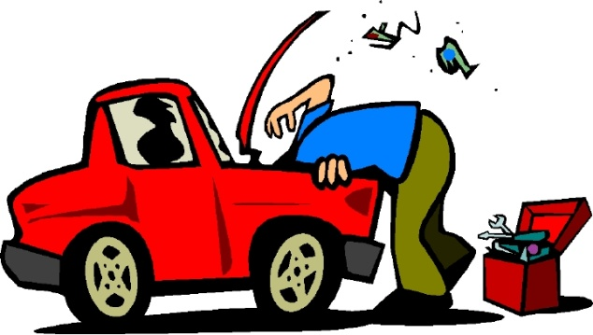
Motion Transmission:
The mechanical function of relaying a motion from one part to another without altering the nature of the motion.
A motion transmission system is a set of components that perform the function of transmitting motion.
Driver Component: Receives the force
Driven Component: receives the motion and transfers it to another part.
Intermediate component: located between the driver and driven component.

Slide 3
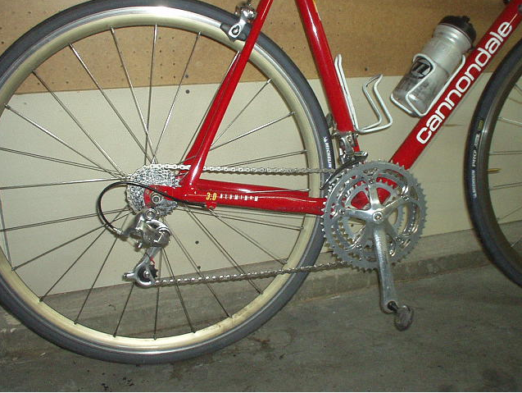
Driver Component
Driven Component
Intermediate Component
Notes:
Driver component: pedal or crankset
Intermediate component: Chain
Driven component: freewheel

Slide 4
Characteristics of Motion in TS
In mechanical engineering, motion transmission systems are often applied to technical objects. The most common systems are:
Gear trains systems
Chain and sprocket systems
Worm and worm gear systems
Friction gear systems
Belt and pulley systems

Slide 5
Characteristics of TS
All transmit rotational motion
The direction of the rotation of the components may be identical throughout or different.
Clockwise or counter clockwise
The system may or may not be reversible.
If it is reversible then the driven component can become a driver and vice versa.

Slide 6
Gears
Gears are generally used for one of four different reasons:
To reverse the direction of rotation
To increase or decrease the speed of rotation
To move rotational motion to a different axis
To keep the rotation of two axis synchronized

Slide 7
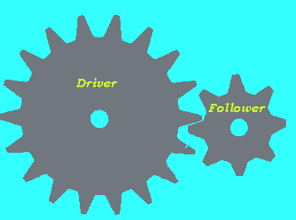
Gear Trains
Gear Ratio:
The number of teeth on the driver divided by the number of teeth on the driven.
Gear Ratio =
18/8 = 2.25
The follower rotates 2,25 times faster than the driver. This gear train can be used to multiply speed on a bicycle if the follower was connected to a wheel and the driver connected to the paddles.

Slide 8
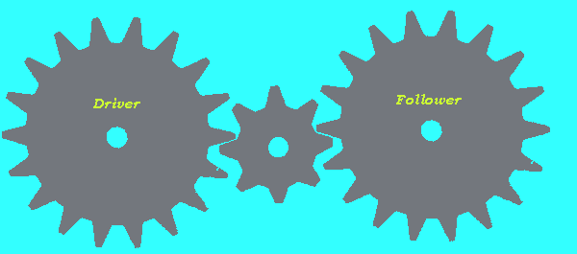
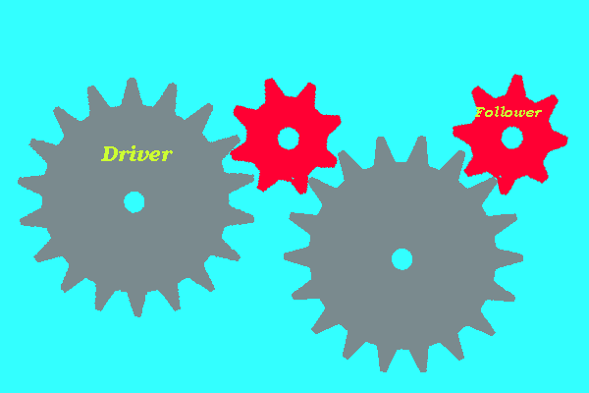
Gear Ratio:
1/1
Gear Ratio:
9/4
Small gear= more turns= faster speed Bigger gears= less turns= slower speed.
Notes:
1:1
8/18

Slide 9
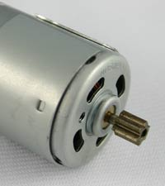
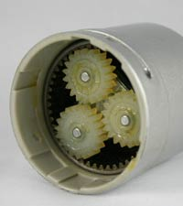
Plenary Gear System
In this gear system, the yellow gear engages all three red gears simultaneously. They are all three attached to a plate, and they engage the inside of the blue gear instead of the outside. Because there are three red gears instead of one, this gear train is extremely rugged.

Slide 10
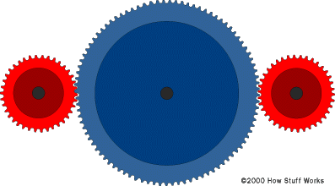
If you have two gears that you want to keep synchronized but some distance apart, What could you do?
1) Add a gear between them:
2) Add a chain

Slide 11
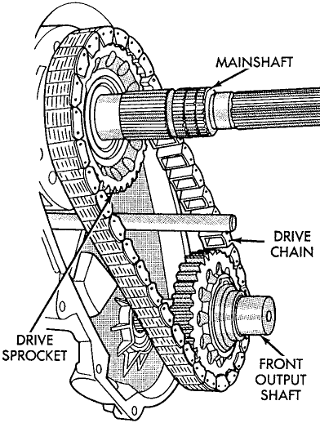
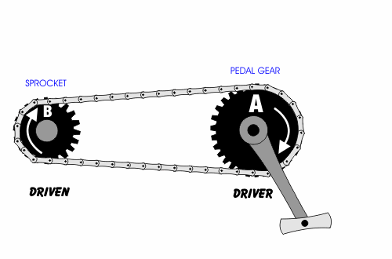
Chain and Sprocket
The gears are no longer touching, they are now called sprockets.

Slide 12
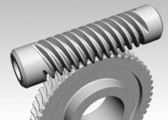
Worm Gears
Worm gears are used when large gear reductions are needed. It is common for worm gears to have reductions of 20:1, and even up to 300:1 or greater.
For each 360° turn of the worm, the worm-gear advances only one tooth of the gear.
Worm
The worm is the driver. The opposite will not work.
Worm gear

Slide 13
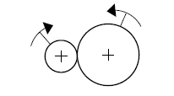
Friction Gear Systems
Similar to a gear train, however the friction gears do not have teeth.
Less efficient than gear trains because the gears can slip.

Slide 14
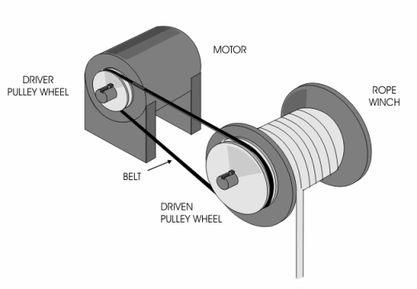
Belt and Pulley System
Similar to a chain and sprocket however, there are no teeth.
The gear without teeth is called the pulley.
The chain is called the belt.

Slide 15
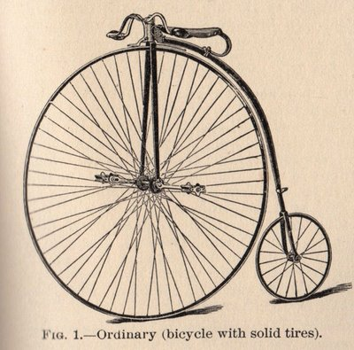
Speed Changes
A speed change occurs in a motion transmission system when the driver does not turn at the same speed as the driven component or components.
Notes:
the pedals and the front wheel are directly connected just like they are on a kid's tricycle. That means that when you turn the pedals one time, the wheel goes around one time. That's an inexpensive way to build a bicycle, but it has a problem. Think about a kid's tricycle. The front wheel might be 16 inches (40 cm) in diameter, or 16 * 3.14 = 50 inches (127 cm) in circumference. That means that each time a kid on a tricycle pedals through one revolution of the front wheel, the tricycle moves forward 50 inches (127 cm). Let's say that the kid is turning the front wheel at 60 rpm, or one revolution per second. That means that the tricycle is moving forward 50 inches per second. That is only 2.8 miles per hour (4.5 kph). If the kid pedals twice as fast, at 120 rpm, the trike is moving at just over 5 miles per hour (9 kph), and the kid looks like his legs are about to spin off because 120 rpm is a lot of pedaling!
If an adult wants to ride a tricycle at a reasonable speed, maybe 15 mph (24 kph), and if the adult does not want his or her legs to fly off, then the tricycle's front wheel has to be pretty big. If the adult wants to pedal at 60 rpm, the front wheel needs to be 84 inches in diameter -- that's 7 feet (more than 2 meters) in diameter!

Slide 16
Speed Changes
Speed Change | Friction gear or belt and pulley | Gear trains or chain and sprocket
Increase | Motion is transmitted to a gear or pulley of smaller diameter | Motion is transmitted from one gear or sprocket to another with fewer teeth.
Decrease | Motion is transmitted to a gear or pulley of larger diameter | Motion is transmitted from one gear or sprocket to another with more teeth.
No change | Motion is transmitted to a gear or pulley with the same diameter. | Motion is transmitted from one gear or sprocket to another with the same number of teeth.

Slide 17
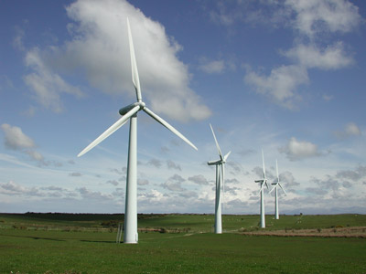
Wind Turbine - Video
Notes:
MOVie

Slide 18
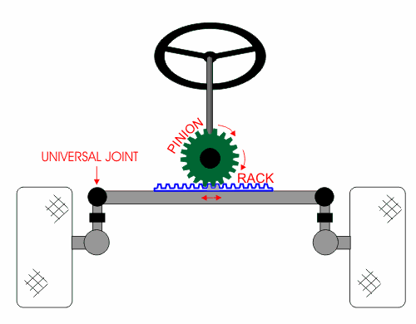
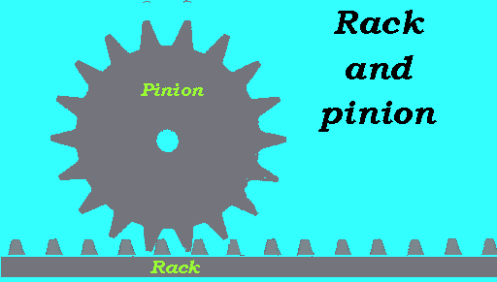
Characteristics of Motion in Transformation Systems
Mechanical action that changes the nature of motion (rotation to translation, translation to rotation)
1) Rack and pinion

Slide 19
Rack and Pinion Systems
Must contain at least 1 gear (pinion) and one straight bar with teeth (rack)
Elements to consider
Teeth must be identical
Requires frequent lubrication
Greater amount of teeth the slower its rotation

Slide 20
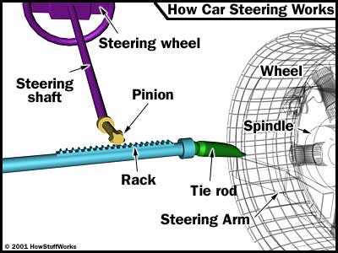
Rack and Pinion
Car steering
The pinion gear is attached to the steering shaft. When you turn the steering wheel, the gear spins, moving the rack. The tie rod at each end of the rack connects to the steering arm on the spindle (see diagram above).
The rack-and-pinion gearset does two things:
It converts the rotational motion of the steering wheel into the linear motion needed to turn the wheels.

Slide 21
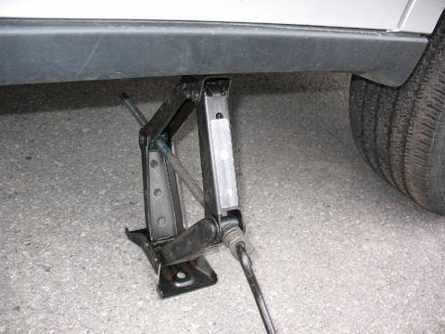
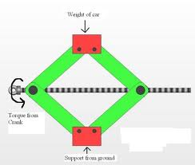
2) Screw Gear System
Rotation causes a translation

Slide 22
Screw Gear Systems
Elements to consider
Type 1- the nut must be connected to the screw in such a way that the nut cannot rotate
In both- the threads of the screws and nuts must match
Type 2- nut must be fixed so that the only possible motion is rotation

Slide 23
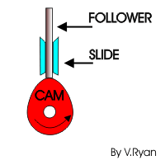
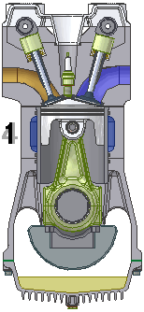
3) Cam and Follower Systems
Rotational motion of the cam is transformed into translational motion of the follower.

Slide 24
Cam and follower
Elements to consider
The follower must be guided in translational motion
Shape of cam determines how the follower will move
A spring is usually required to keep follower in contact with cam
http://www.ul.ie/~kirwanp/whatisacamandfollowersyste.htm

Slide 25
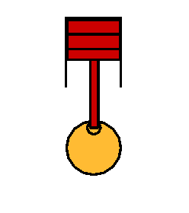
4) Slider-Crank Mechanism
piston
Connecting rod
Crank
Translational motion of the piston is transformed into rotational motion of the crank.
Notes:
There is a video link attached to picture of the motor

Slide 26
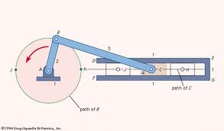
Slider Crank Mechanisms
Elements to Consider
Rod contains 2 bushings to connect it to the crank
The cylinder must guide the part moving in translation
Requires frequent lubrication

